Slide 1







STARTER HOME INITIATIVE
VIRTUAL CONVENING
SPONSORED BY:
FEATURING:

Slide 2



KELLY CAUFIELD
EXECUTIVE DIRECTOR
CSI COLORADO
HEIDI WILLIAMS
PRESIDENT & CEO
CIVIC RESULTS

Slide 3
THE STARTER HOME INITIATIVE
  A facts-based initiative to support cities and counties aiming to increase the supply of starter homes across Colorado.
  Will lead to the creation of a Housing Framework, an adaptable template to help communities plan for mortgage capacity aligned starter homes through updated land use tools and design flexibility.
  Through two convenings, the initiative will equip local leaders with practical tools to align regulations with the realities of today’s housing market.
  Initiative culminates in a housing summit in December in Denver.

Slide 4

PETER LIFARI
CHIEF EXECUTIVE OFFICER
MAIKER HOUSING PARTNERS
2025 HOUSING FELLOW
COMMON SENSE INSTITUTE

Slide 5
WHAT IS A STARTER HOME?
  Compact, efficient homes — typically 1,000–1,200 sq. ft.
  Designed to align with local mortgage capacity and help first-time buyers build equity.
  Emphasizes small lot detached single-family homes that fit local character and expand ownership opportunities.
The Housing Framework helps communities modernize local tools and design standards to make these homes feasible again

Slide 6

AUGUST 2025
COLORADO’S HOUSING AFFORDABILITY MISMATCH
REPORT

Slide 7
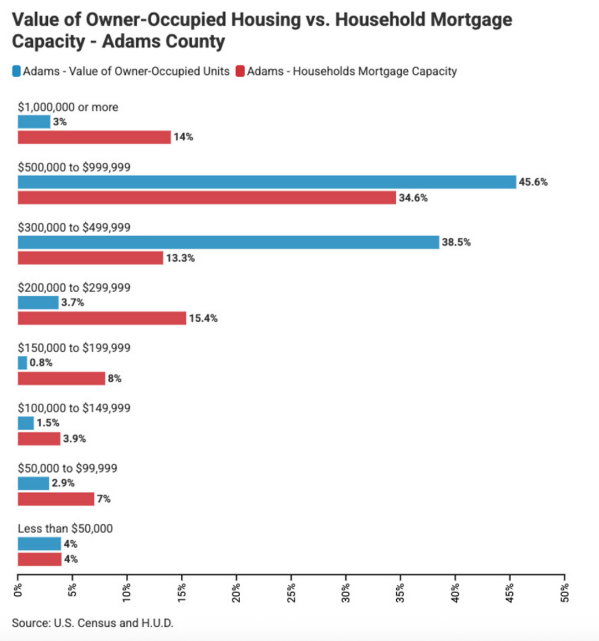
Homes largely out of reach:
In 2023, 60.2% of Colorado households did not earn enough to afford the average home—up from 46.8% in 2010.

Slide 8

JUNE 2025
COLORADO HOUSING AFFORDABILITY
REPORT
REPORT

Slide 9
DENVER METRO AREA HOUSING
AFFORDABILITY - MAY 2025
2025
Declining affordability increased the number of hours the average homeowner in Colorado's major cities had to work from 2015 to 2025 to cover monthly mortgage payments.
2015
50 hours per week
97 hours per week

Slide 10
DENVER METRO AREA HOUSING
AFFORDABILITY - MAY 2025
2024
Housing Deficit
2028
Housing Needed
64,095 to 135,139
housing units
37,520 to 55,331 housing units per year

Slide 11
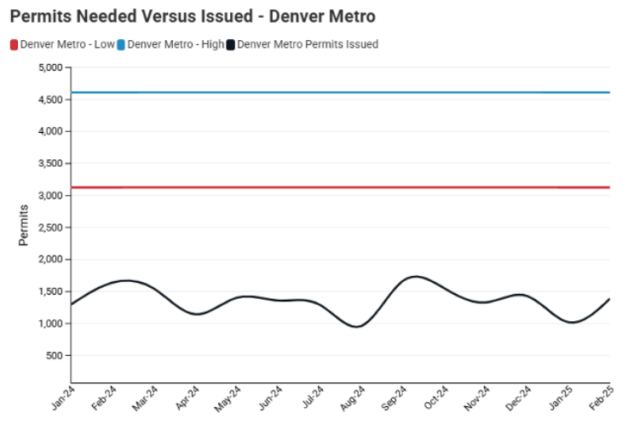
PERMIT LAGS
The number of housing unit permits needed in the Denver Metro Area to close the deficit by 2028

Slide 12
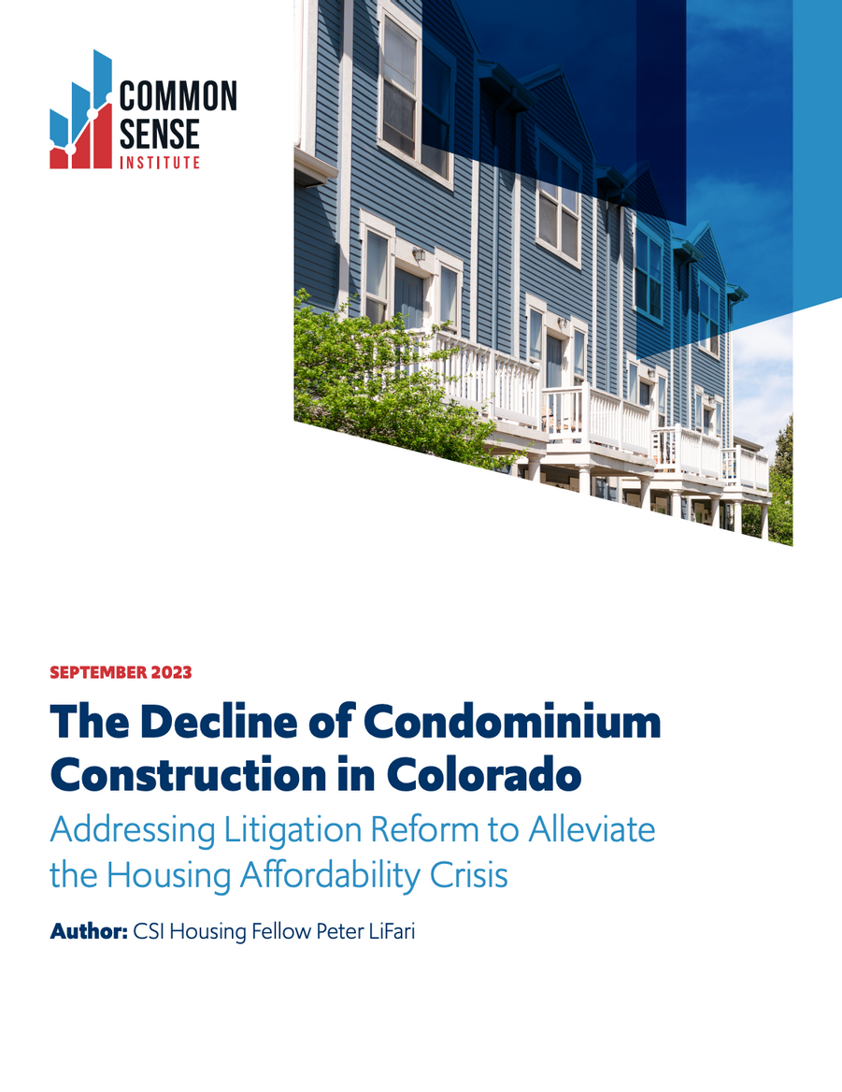
SEPTEMBER 2023
THE DECLINE OF CONDOMINIUM CONSTRUCTION IN COLORADO
REPORT

Slide 13
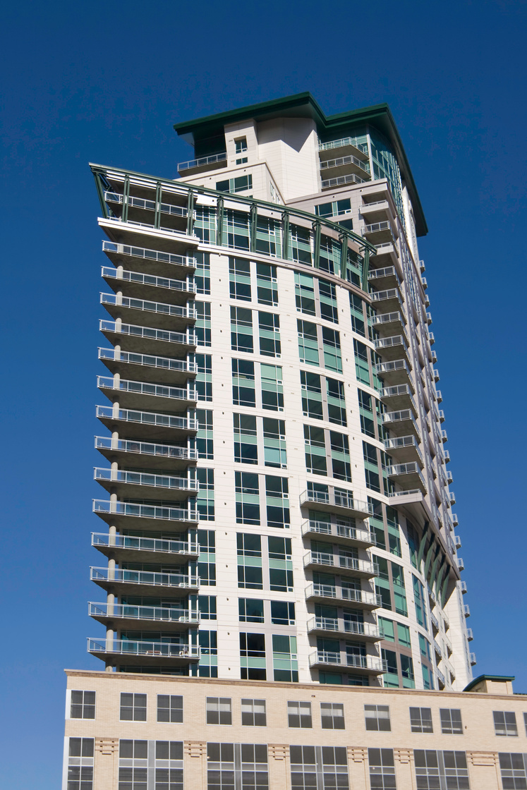
KEY FINDINGS
Since 2018, there has been 14 new apartments for every 1 new condo while there was 1 new condo for every 1.25 apartments in the 6 years prior to 2009.

Slide 14
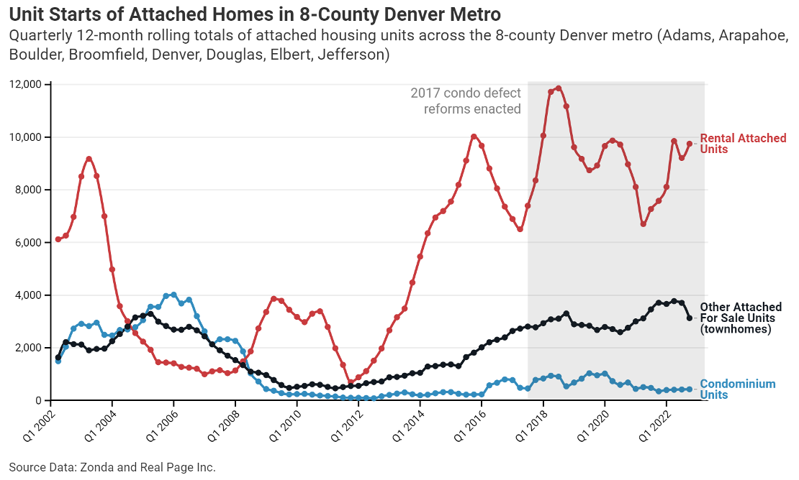
DECREASE IN CONDOS
Townhomes & apartments have recovered while condos have not

Slide 15

SEPTEMBER 2025
FROM FOUNDATIONS TO FUTURES:
THE ECONOMIC RIPPLE OF THREE COMMUNITIES IN COLORADO
REPORT

Slide 16
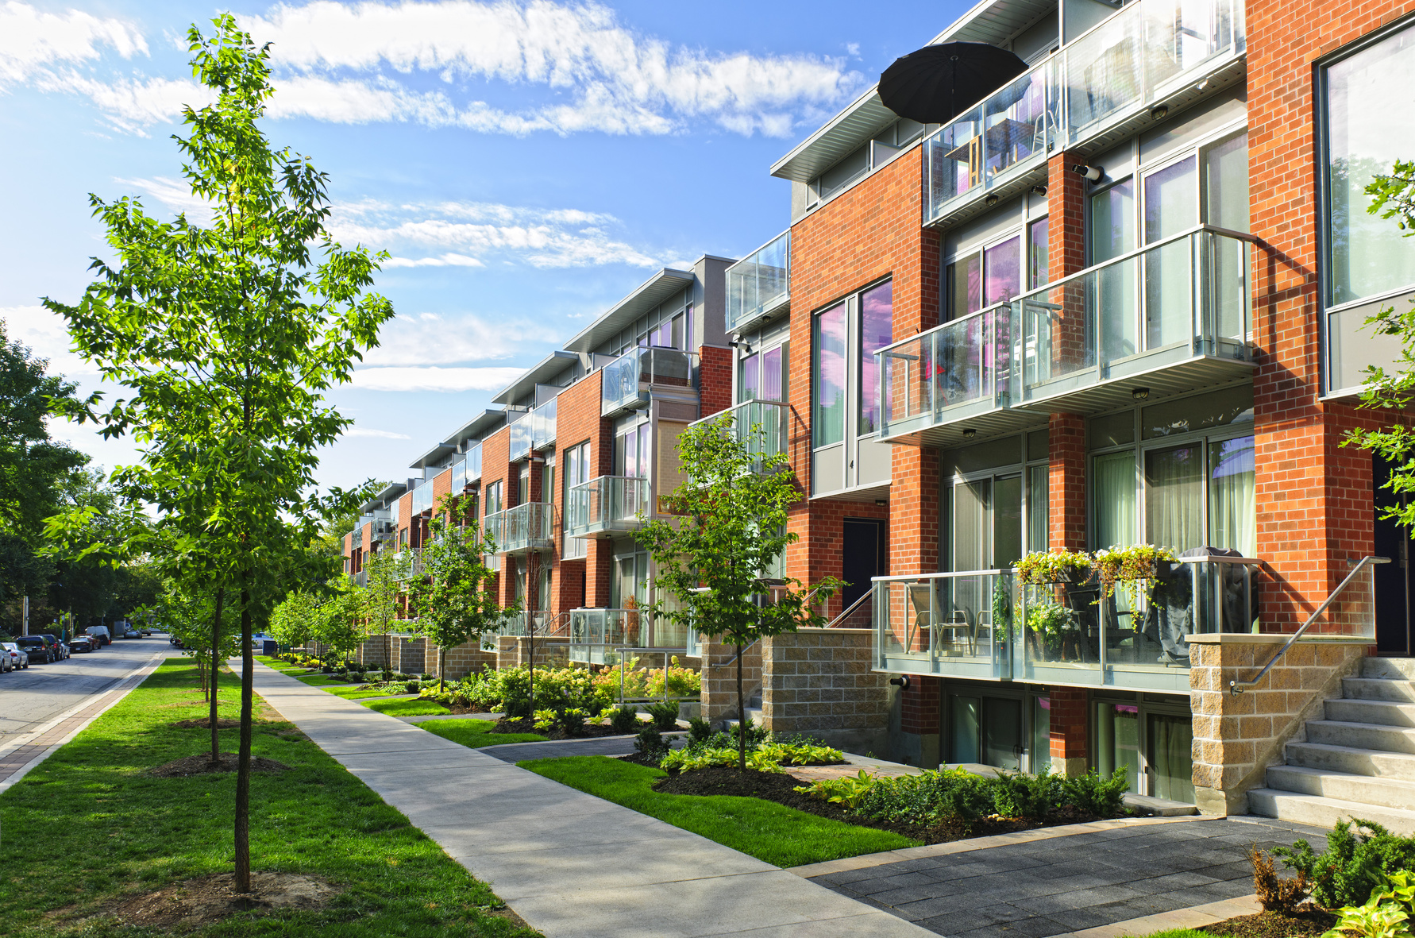

KEY FINDINGS
Strategic housing supply relieves pressures and creates positive economic impacts
CSI’s modeling of three developments confirms affordability improvements due to increased supply

Slide 17
ECONOMIC IMPACTS OF THE DEVELOPMENTS
Westminster’s Bradburn Village & Longmont’s Prospect New Town
$350 Million
Disposable personal income
Over $1 Billion
Boost to economic output
Over 4,000
Jobs
2,000
Residents attracted
Notes:
An increase in disposable personal income of more than $350 million in this region from
construction and development;
> A boost to economic output of more than $1 billion from the construction and housing stock
expansion (this outcome is driven largely by the historical construction efforts and private
investments in this community);
> Over 4,000 jobs (one-time and ongoing) associated with the construction and build-out/
occupation of the properties; and
COMMON SENSE INSTITUTE :: COMMONSENSEINSTITUTECO.ORG 8SEPTEMBER 2025 // THE ECONOMIC RIPPLE OF THREE COMMUNITIES IN COLORADO
• The two projects are estimated to have attracted nearly 2,000 residents to the Denver Metro area

Slide 18
ECONOMIC IMPACTS OF THE DEVELOPMENTS
Buena Vista’s South Main
$270 Million
Disposable personal income
Over $331 Million
Boost to economic output
Over 1,650
Jobs
More than 3,300
Residents attracted

Slide 19

HEIDI WILLIAMS
PRESIDENT & CEO
CIVIC RESULTS

Slide 20
FUTURE HOUSING COALITION TOOLKIT

Slide 21



ABOUT CIVIC RESULTS
HEIDI K. WILLIAMS
MAGGIE GRAVES
CHRISTINA NOTO
PRESIDENT & CEO
PROGRAM MANAGER
PROGRAM & OPERATIONS
ASSOCIATE

Slide 22



FUTURE HOUSING COALITION (FHC)
Address Colorado’s complex housing challenges
Work with diverse stakeholders to develop practical solutions
Create a four-part toolkit for local governments

Slide 23




THE 4-PART MIDDLE HOUSING TOOLKIT
  Communication Engagement Plan for Local Governments
  Policy and Land Use Regulations
  Private Industry Construction & Development
  Financing Tools and Options

Slide 24
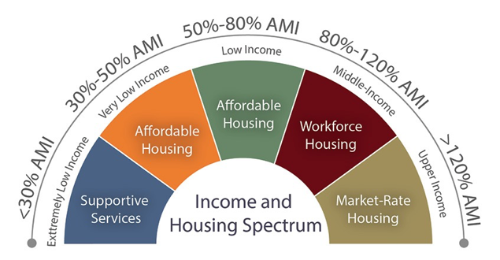
MIDDLE INCOME
IMAGE SOURCE: SILVERTON COLORADO HOUSING AUTHORITY

Slide 25




FUTURE HOUSING COALITION TOOLKIT
2025
2025
2026
2026
PHASE 1
PHASE 2
PHASE 3
PHASE 4
Community Engagement & Education
Model Codes for Local Governments
Best Practices for Developers & Builders
Financing Tools & Best Practices

Slide 26

COMMUNICATION ENGAGEMENT PLAN FOR LOCAL GOVERNMENTS

Slide 27
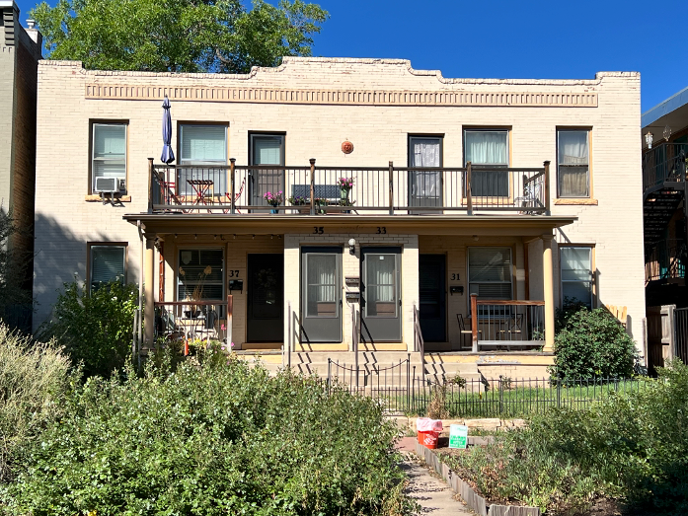
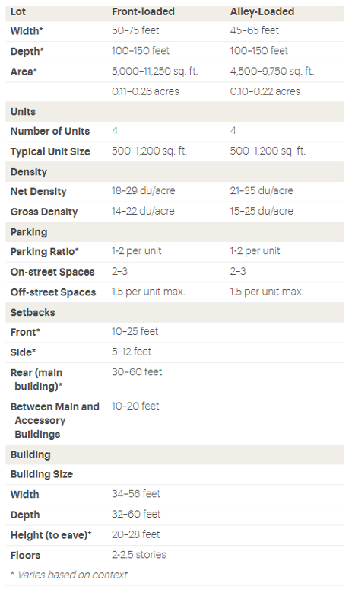
PHOTO LIBRARY OF MIDDLE HOUSING
IMAGE SOURCE: CHRISTINA NOTO (LEFT), MISSING MIDDLE HOUSING (RIGHT)

Slide 28

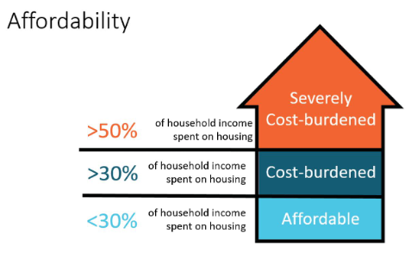
STORY TELLING TOOLS
Englewood 1 School District
Arapahoe County
Mapleton 1 School District
Adams County
Average Salary
Average Salary
$72,803.00
$84,216.00
Arapahoe County Median Monthly Mortgage Payment
Adams County Median Monthly
Mortgage Payment
$3,510
$3,060
Percent of Income Toward Mortgage
Percent of Income Toward Mortgage
58%
44%
Salary Needed to Not
Be Housing Burdened
Salary Needed to Not
Be Housing Burdened
$140,400
$122,400
IMAGE SOURCE: HOLLY SPRINGS, NC

Slide 29
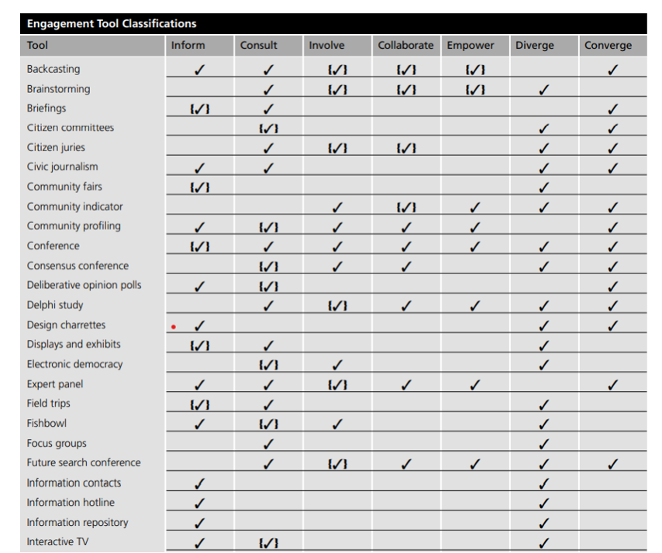
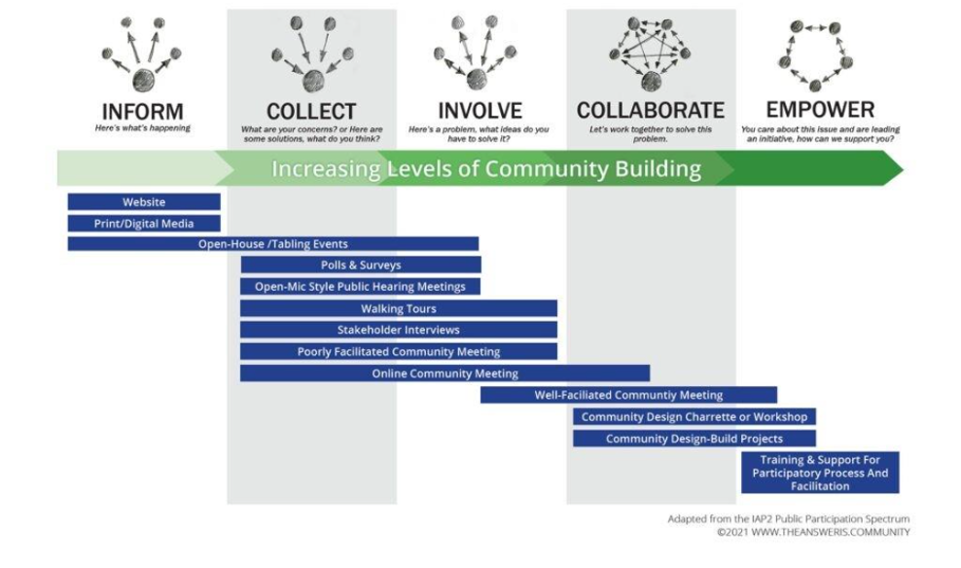
PUBLIC ENGAGEMENT TECHNIQUES
IMAGE SOURCE: HIGBEE (LEFT), DEPARTMENT OF SUSTAINABILITY AND ENVIRONMENT (RIGHT)

Slide 30

SLIDES FOR PUBLIC MEETINGS

Slide 31
HELPFUL INFORMATION
KEY TERMS
FAQ SHEET
  Age in Place
  Area Median Income (AMI)
  Density Bonuses
  Floor Area Ratio (FAR)
  Retrofit
  Form Based Zoning
  Neighborhood Character & Property Values
  Parking and Traffic
  Schools & Infrastructure
  Safety & Social Concerns
  Design, Development & Process
  Clarifying Misconceptions

Slide 32
FUTURE HOUSING COALITION TOOLKIT
2025
2025
2026
2026
PHASE 1
PHASE 2
PHASE 3
PHASE 4
Community Engagement & Education
Model Codes for Local Governments
Best Practices for Developers & Builders
Financing Tools & Best Practices

Slide 33
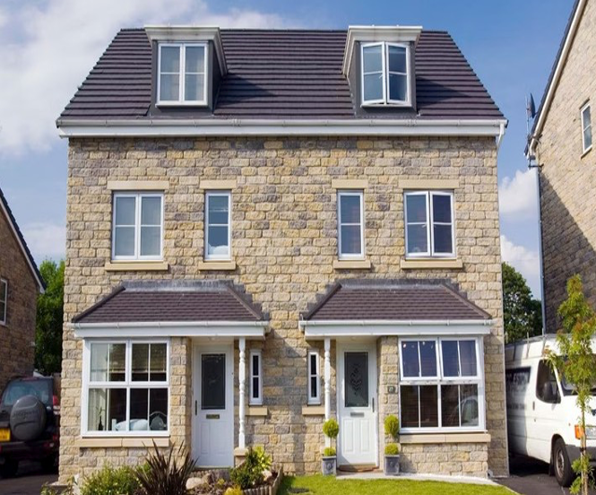
MODEL CODES FOR MIDDLE HOUSING
  Twin Homes
  Duplexes
  Triplexes
  Fourplexes
  Townhomes & Rowhomes
  Live/Work Homes
  Cottage/Bungalow Court & Courtyard Homes
  Mansion Apartments
IMAGE SOURCE: MISSING MIDDLE HOUSING

Slide 34
FUTURE HOUSING COALITION TOOLKIT
2025
2025
2026
2026
PHASE 1
PHASE 2
PHASE 3
PHASE 4
Community Engagement & Education
Model Codes for Local Governments
Best Practices for Developers & Builders
Financing Tools & Best Practices

Slide 35
BEST PRACTICES FOR DEVELOPERS AND HOME BUILDERS
BEST PRACTICES FOR WORKING WITH PLANNING STAFF
CITY/COUNTY COUNCIL MEETINGS & PUBLIC HEARINGS
HOW & WHEN TO ENGAGE ELECTED OFFICIALS
PRE-APPLICATION BEST PRACTICES
CHECKLIST OF REQUIREMENTS FOR MUNICIPALITIES

Slide 36
FUTURE HOUSING COALITION TOOLKIT
2025
2025
2026
2026
PHASE 1
PHASE 2
PHASE 3
PHASE 4
Community Engagement & Education
Model Codes for Local Governments
Best Practices for Developers & Builders
Financing Tools & Best Practices

Slide 37
BEST PRACTICES FOR DEVELOPERS AND HOME BUILDERS
LOCAL GOVERNMNET & DEVELOPER PARTNERSHIPS
FEDERAL & STATE PARTICIPATION & INCENTIVES
LOCAL GOVERNMENT PARTICIPATION & INCENTIVES
SUCCESSFUL MIDDLE HOUSING DEVELOPMENT EXAMPLES
RESOURCE LIST OF FUNDING SOURCES

Slide 38

USING THE TOOLKIT

Slide 39



WHO CAN USE IT?
  City and County Planners
  Chamber of Commerce
  Elected Officials
  Charrette Facilitators
  Home-Owner and Neighborhood Associations
  Home Builders & Developers

Slide 40
FHC TOOLKIT - TAKE AWAYS
  The Challenge: Colorado faces a growing housing affordability and availability crisis.
  The Opportunity: Middle housing is a critical part of the solution.
  The Toolkit: Provides practical, Colorado-specific strategies for local leaders.
  Your Role: Share, adapt, and implement resources to strengthen housing options in your community.
  The Impact: Together, we can create more attainable homes for teachers, nurses, first responders, and families across Colorado.

Slide 41

DON ELLIOTT
SENIOR CONSULTANT
CLARION ASSOCIATES

Slide 42
STARTER HOME ZONING OUTLINE PROCESS

Slide 43
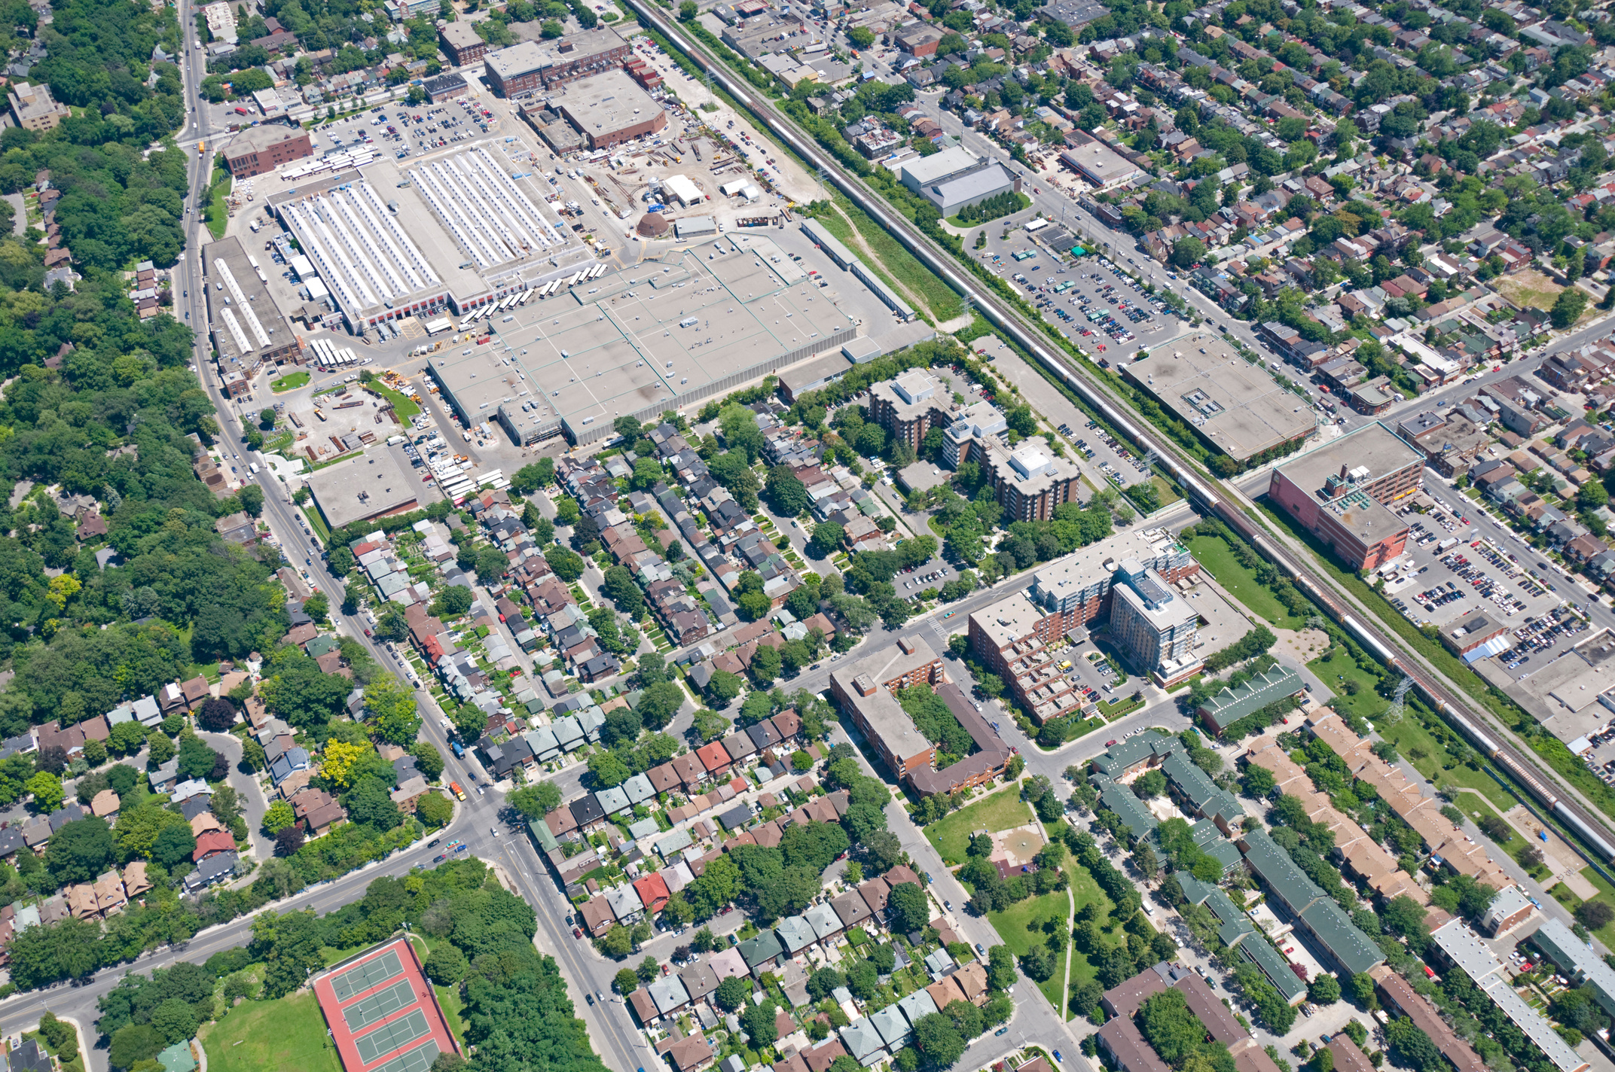
BARRIERS TO STARTER HOME CONSRUCTION
Zoning is not the only barrier, but it can be a significant one:
  A major source of uncertainty that discourages investment
  Particularly for new/innovative housing products
Other Sources of Delay Include:
  Construction defects legislation
  Shortages of skilled trade personnel
  Misalignment of zoning, subdivision, and engineering standards
  Subdivision procedure time and expense
  Infrastructure availability and cost
  Development impact fees that do not reflect size/affordability
  Administrative permitting delays

Slide 44

THE DRAFTING PROCESS
October
  Present SH zoning outline at Virtual Convening (today)
  Call stakeholders to refine zoning framework outline
November
  Draft SH zoning framework
December
  Present SH zoning framework at Housing Summit
  Refine SH zoning framework based on Summit comments

Slide 45
DRAFTING CHALLENGES
Different Zoning Code
Formats and Structures
Different Regions
of the State
Different Types of Starter Homes
  Use-based, Form-based, Performance-based, and hybrids
  Lists of uses – vs. tables
  Integrated zoning procedures vs. dispersed
  Integrated development and design standards vs. dispersed
  Urban and inner suburbs
  Rural counties and growing outskirts
  High country mountains and resort
  SF detached with ADUs, duplex, triplex, fourplex, cottages

Slide 46

START WITH THE BASICS
The basic form of Starter Homes
  Single-family detached homes on small individual lots or parcels
  Include an ADU option
The basic context for SFD SH development
Focus on the key substance for successful SH development
  Rural counties and growing outskirts
  The most likely location for significant land assemblages
  Many urban cities and inner suburb zoning codes are already considering zoning reforms to allow smaller homes/lots.
  Mountain and resort lands often require tailored solutions.
  Present the content so it can be integrated into many types of zoning code structures
  “Staple it on” chapters seldom work well

Slide 47
SHOW WHERE & HOW IT CAN BE TAILORED
  Show where the framework for single-family detached homes in a rural counties / growing suburbs context can be tailored to apply to:
    Other community contexts
      Mountain & resort communities / urban & inner suburbs
    Other form of SH housing
      e.g. duplex, triplex, fourplex, cottages
  Indicate what additional issues / challenges will need to be addressed through tailoring (or the direction the tailoring will need to take to be effective

Slide 48
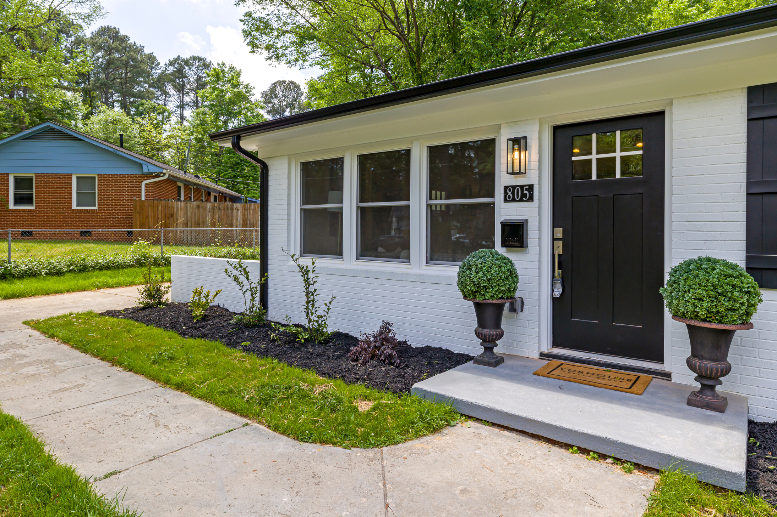
TOPICS TO BE ADDRESSED
  A description of the type of starter home being allowed
  Minimum/maximum lot dimensions and standards for that product
  Minimum/maximum building dimensions for that product
  Basic site and building design standards or menus for that product
  Procedures for approval of individual developments after SH zoning has been adopted
  Administrative procedures for approving minor variations from the SHZT to accommodate different builders’ models and products
  Definitions of key terms

Slide 49

QUESTIONS?
COMMONSENSEINSTITUTECO.ORG

